Slide 1
Previously on
Mechatronic equipment
Mechatronic equipment

Slide 2
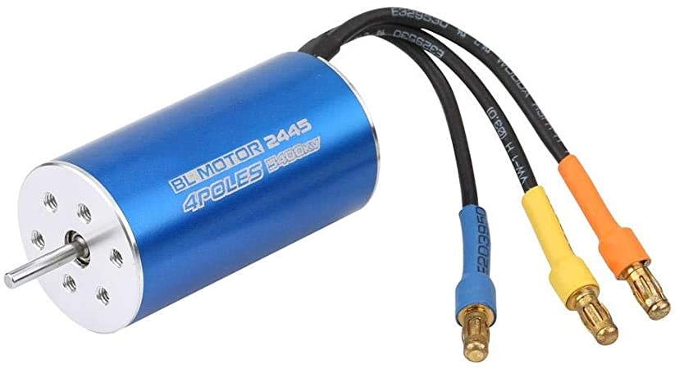

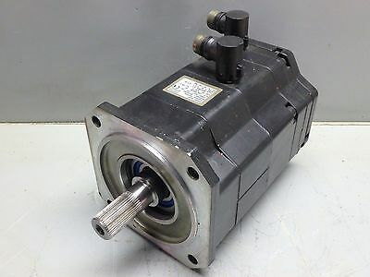
EC DC motors
DC motors that do not have a collector nor brushes whose armature current is controlled by an electric switching unit are called electrically commutated motors (EC motor, electronic motor, brushless motor, BLDC motor, commutatorless motor)

Slide 3
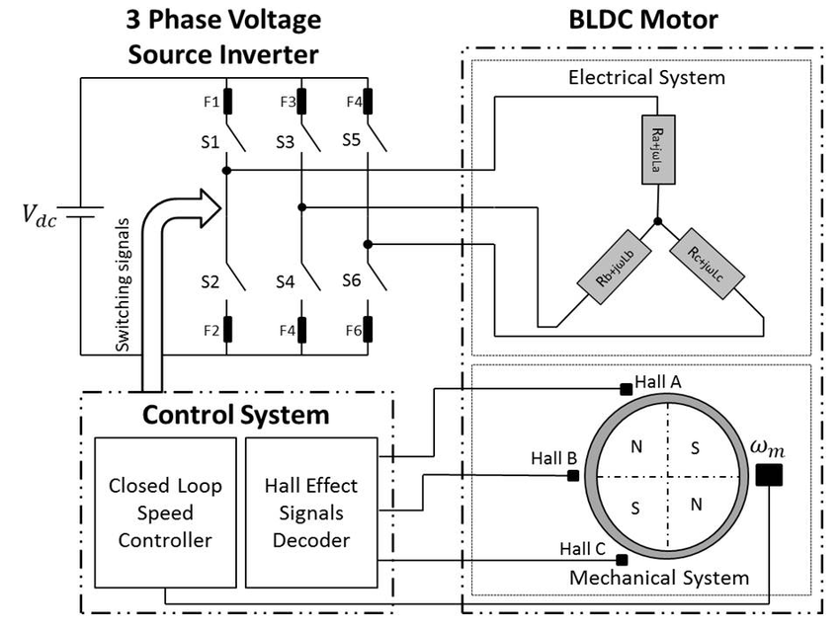
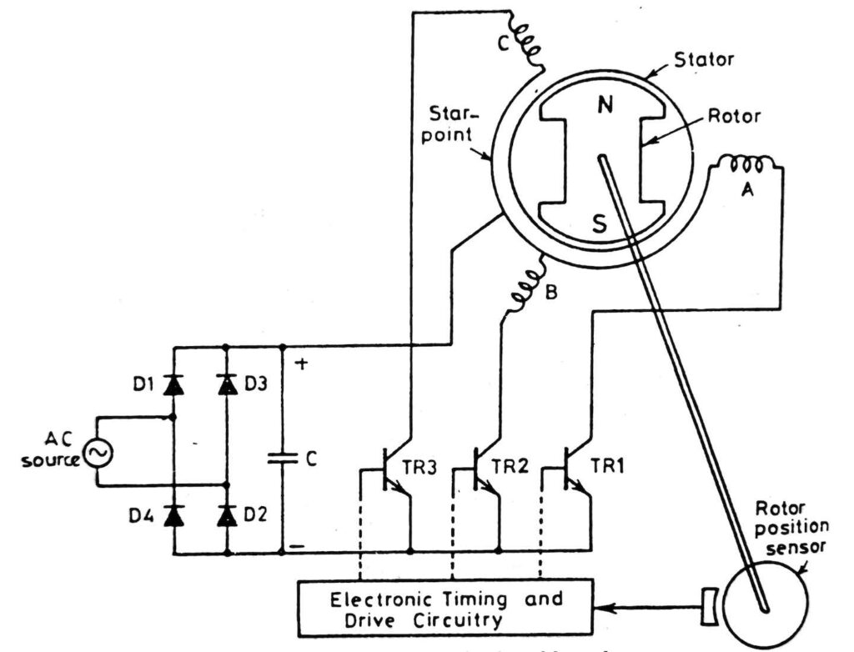
Three phase BLDC
3 Half-sines drive
6 Half-sines drive

Slide 4
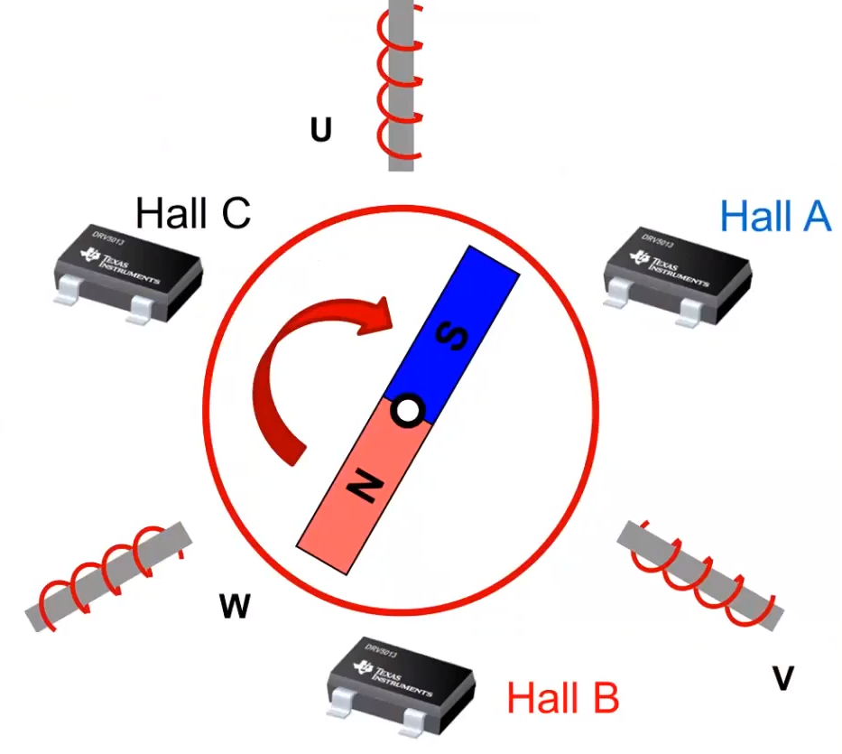
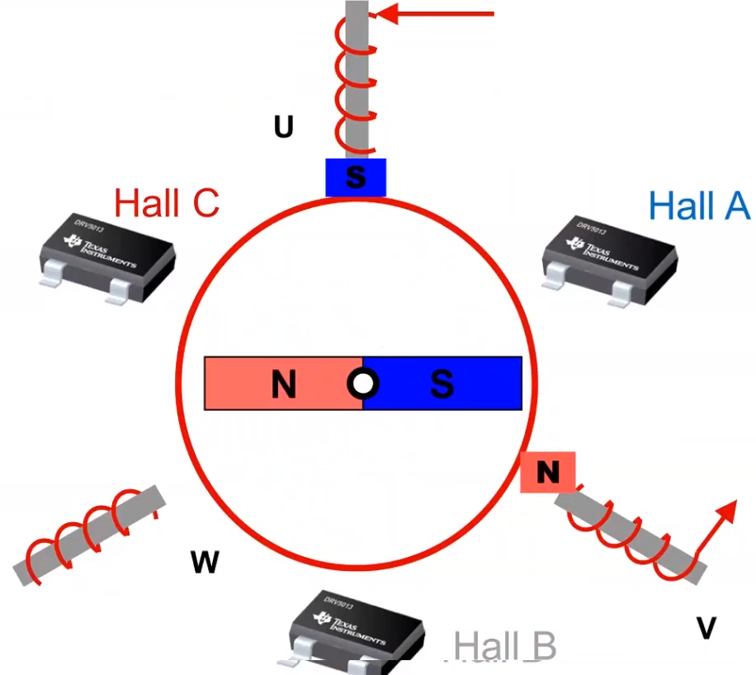
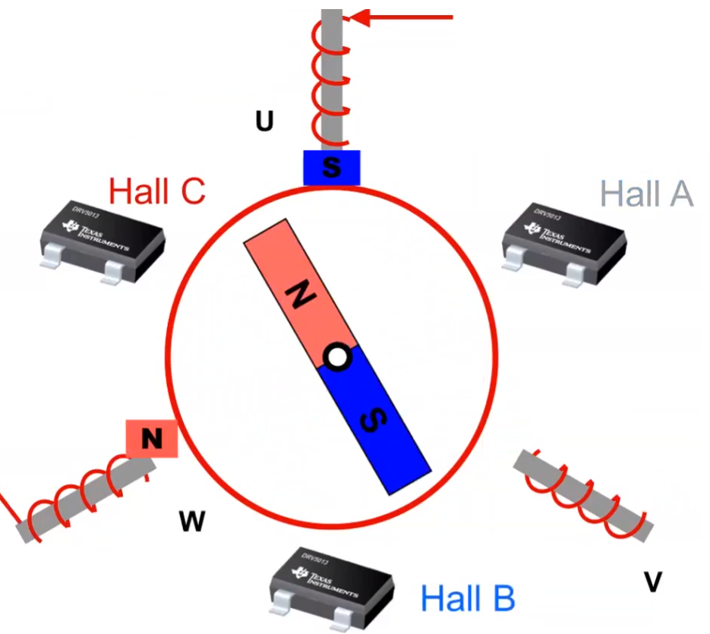
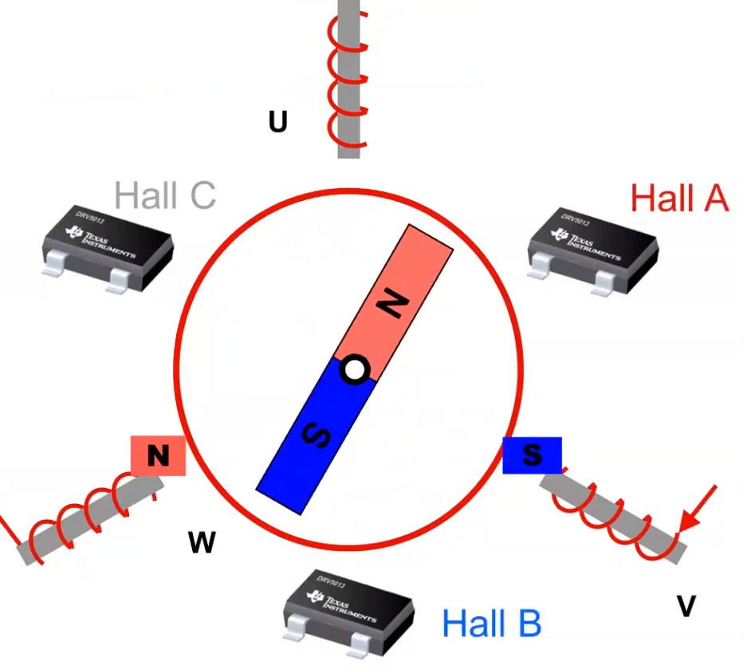
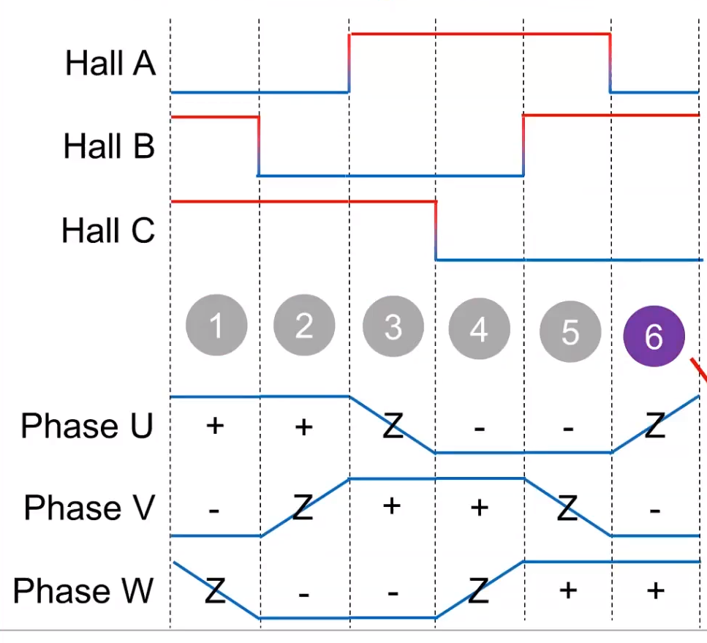
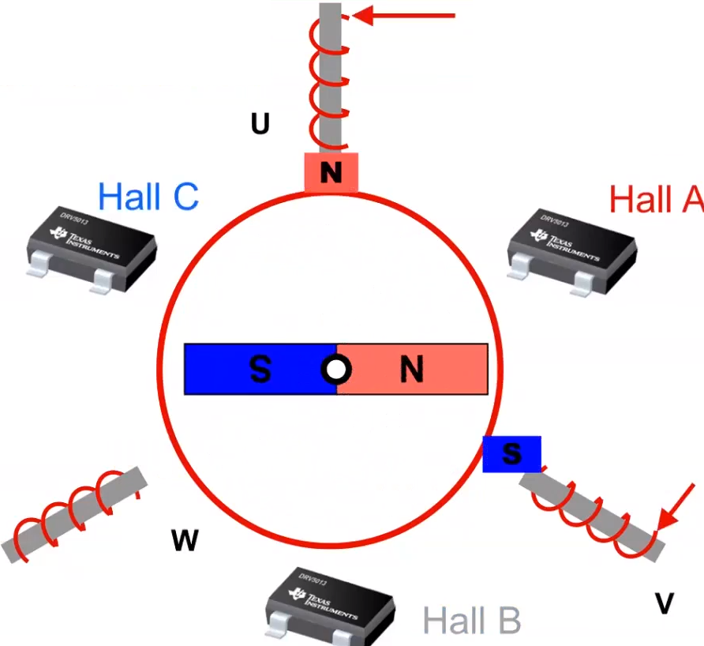
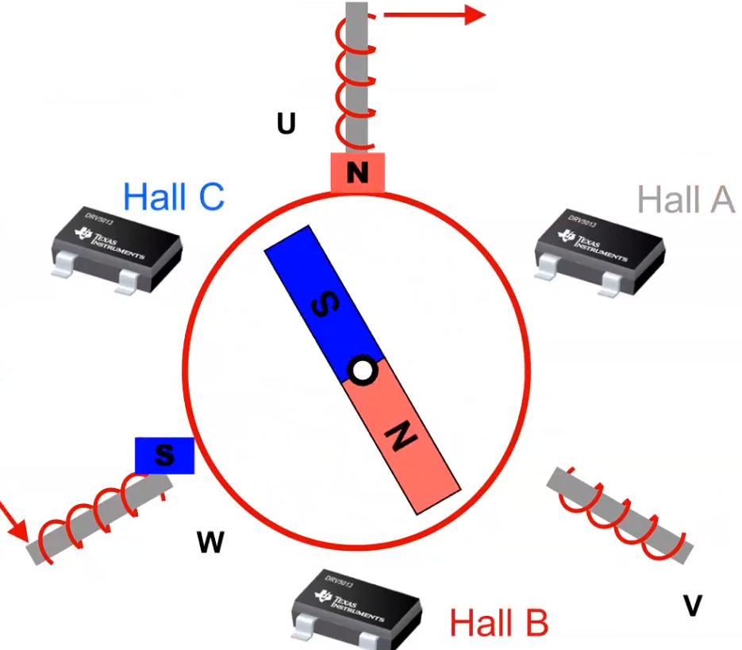
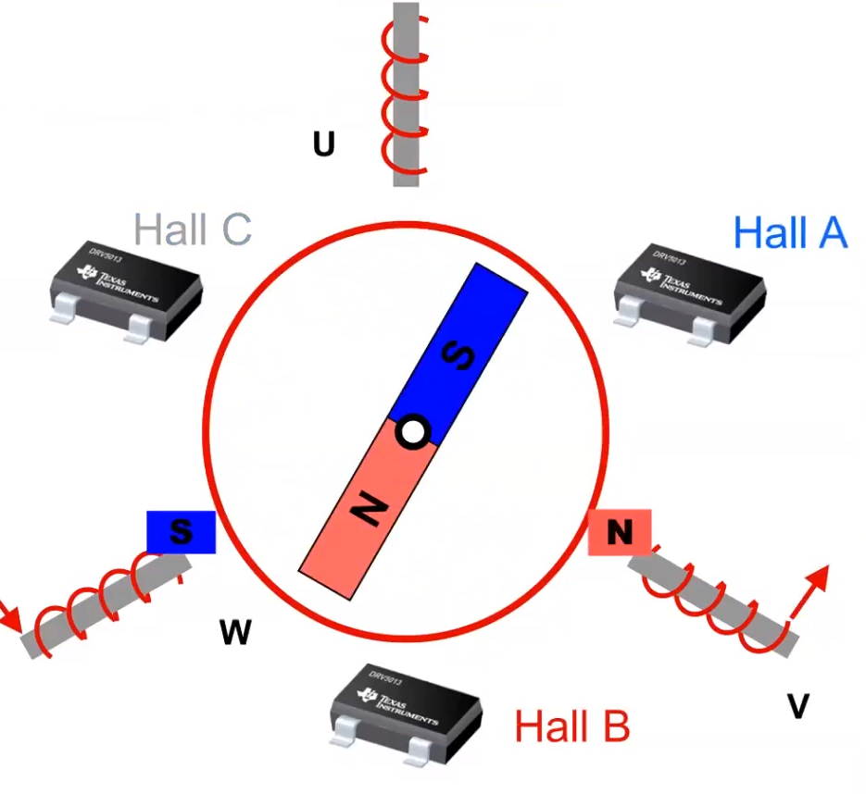
Trapezoidal commutation
1
2
3
4
5
6

Slide 5
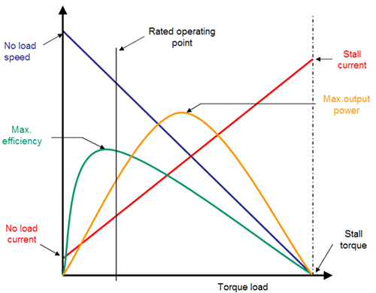
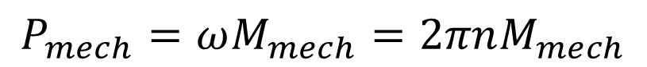
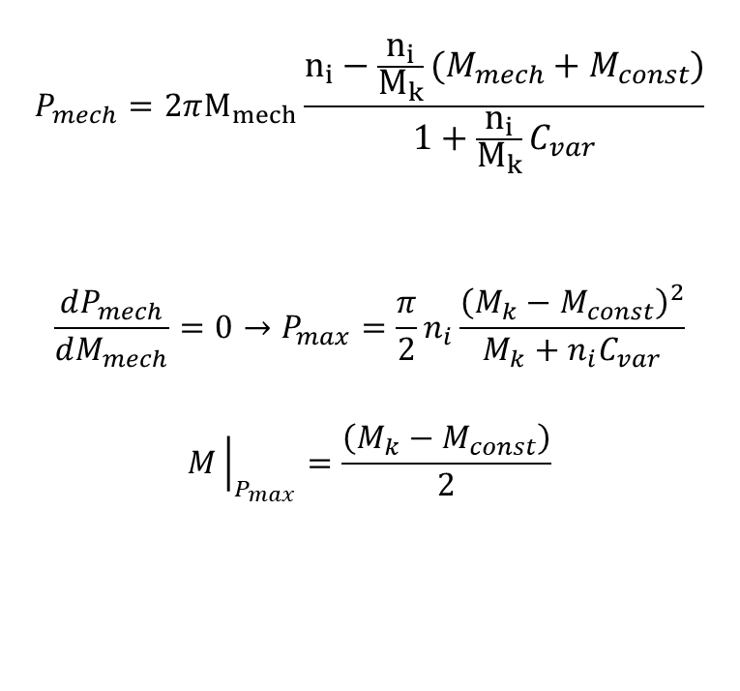
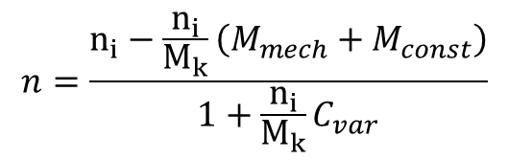
Power
$$n=\frac{n_{i}−\frac{n_{i}}{M_{k}}\left(M_{mech}+M_{const}\right)}{1+\frac{n_{i}}{M_{k}}C_{var}}$$
$$P_{mech}=ωM_{mech}=2πnM_{mech}$$
$$P_{mech}=2πM_{mech}\frac{n_{i}−\frac{n_{i}}{M_{k}}\left(M_{mech}+M_{const}\right)}{1+\frac{n_{i}}{M_{k}}C_{var}}$$
$$\frac{dP_{mech}}{dM_{mech}}=0→P_{max}=\frac{π}{2}n_{i}\frac{{\left(M_{k}−M_{const}\right)}^{2}}{M_{k}+n_{i}C_{var}}$$
$$M{\left.​\right|}_{P_{max}}=\frac{\left(M_{k}−M_{const}\right)}{2}$$

Slide 6
Mechatronic Equipment: Stepper motors
Vilius Vertelis
vilius.vertelis@vilniustech.lt
2021

Slide 7
What’s a stepper motor?
Stepper motor is a brushless DC motor that divides a full shaft rotation into a series of equal discrete steps.
Stator of a stepper motor has no less than two windings that are fed DC current from a commutator.
3 types:
Permanent magnet stepper
Variable reluctance stepper
Hybrid synchronous stepper

Slide 8
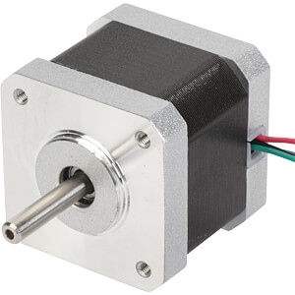
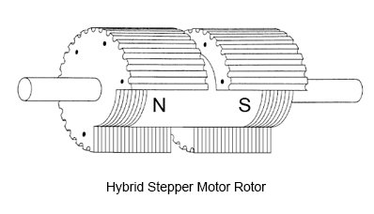
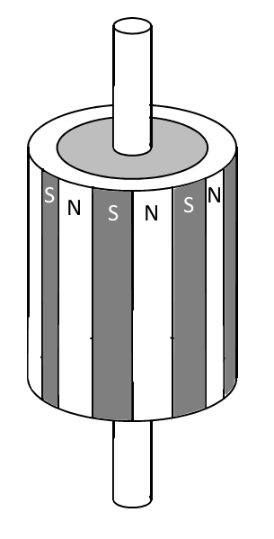
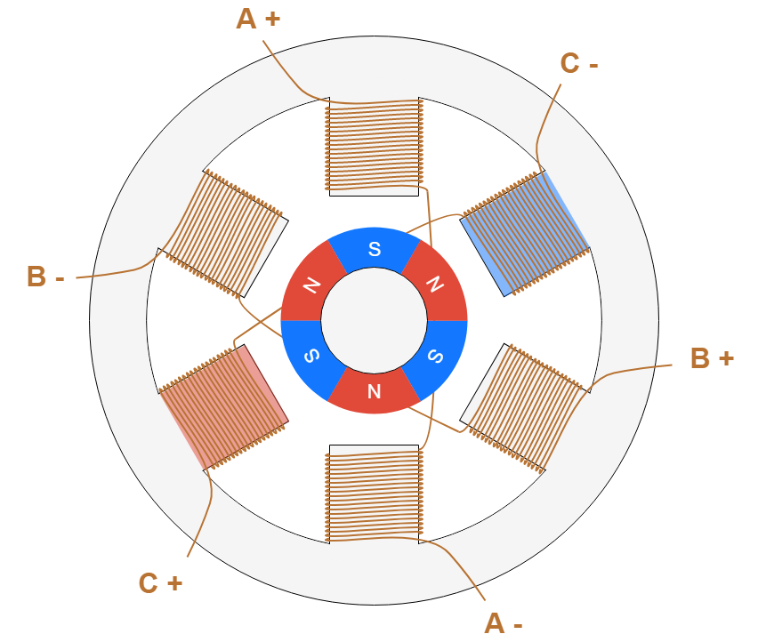
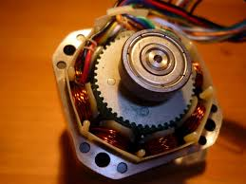
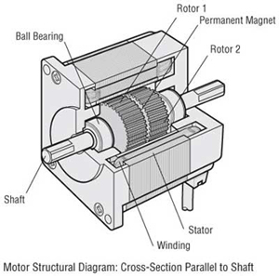
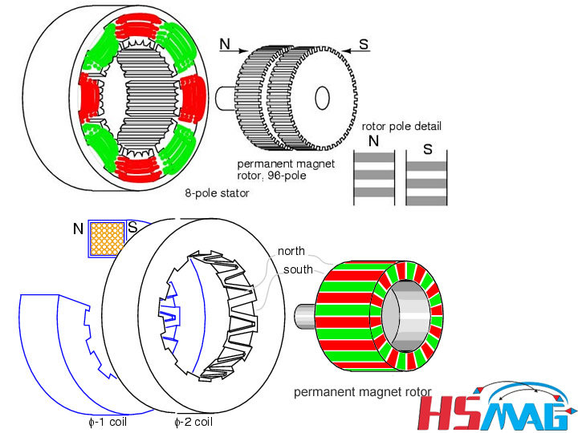
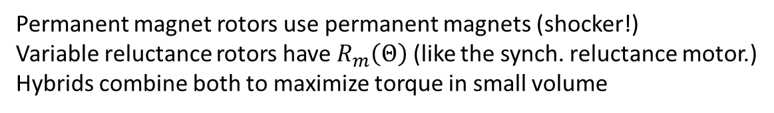
What’s a stepper motor?
Permanent magnet rotors use permanent magnets (shocker!)
Variable reluctance rotors have $R_{m}\left(Θ\right)$ (like the synch. reluctance motor.)
Hybrids combine both to maximize torque in small volume
Variable reluctance rotor
Permanent magnet

Slide 9
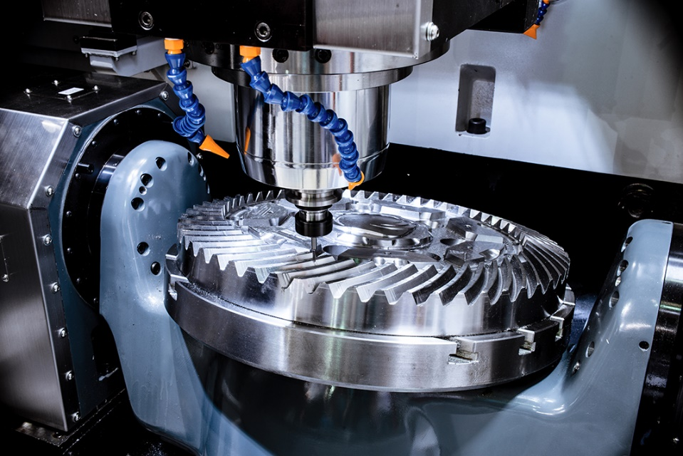
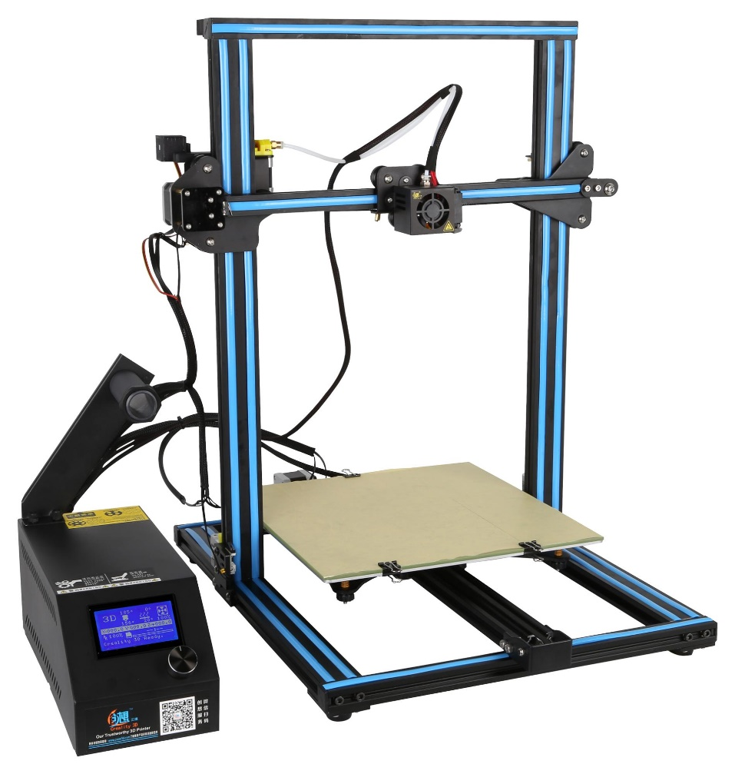
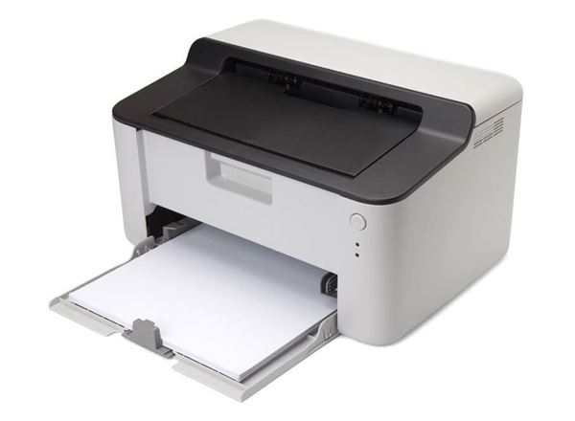
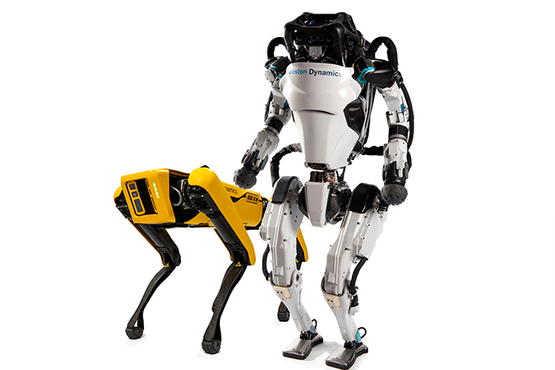
Uses

Slide 10
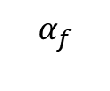
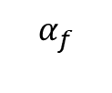
Stepped magnetic field
$$α_{f}$$
$$α_{f}$$
t
t
Field angle of a rotating field
Field angle of a stepped field

Slide 11
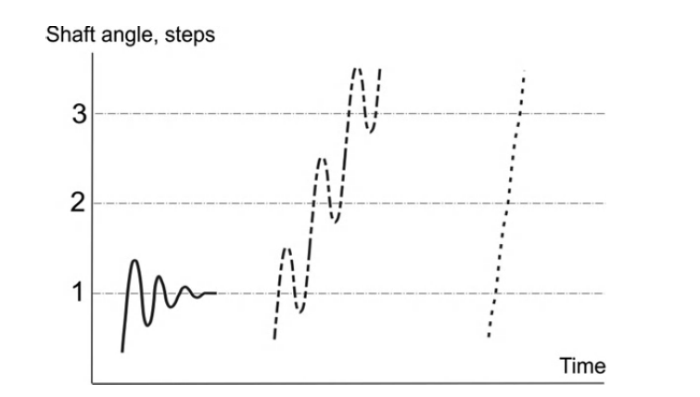
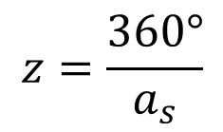
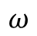
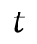
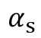
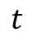
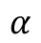
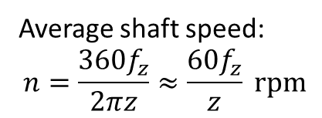
Shaft angle and angular velocity
$$ω$$
$$t$$
$$α$$
Number of steps:
$$α_{s}$$
$$z=\frac{360°}{a_{s}}$$
$$t$$
Average shaft speed:
$$n=\frac{360f_{z}}{2πz}≈\frac{60f_{z}}{z} rpm$$

Slide 12
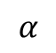
Stepper motor drive
1
$$α$$
2
Step command
3
4
Logic
Power section
M
Direction command

Slide 13
Driving
Wave drive a single phase is activated at a time. It has the same number of steps as the full-step drive, but the motor will have significantly less torque than rated. It is rarely used.
Full-step drive - this is the usual method for full-step driving the motor. Two phases are always on so the motor will provide its maximum rated torque. As soon as one phase is turned off, another one is turned on. Wave drive and single phase full step are both one and the same, with same number of steps but difference in torque.

Slide 14
Driving
Half-stepping -When half-stepping, the drive alternates between two phases on and a single phase on. This increases the angular resolution. The motor also has less torque at the full-step position (where only a single phase is on). The advantage of half stepping is that the drive electronics need not change to support it.
Microstepping – (often sine–cosine microstepping) winding current approximates a sinusoidal AC waveform. The common way to achieve sine-cosine current is with chopper-drive circuits. Sine–cosine microstepping is the most common form, but other waveforms can be used. As the microsteps become smaller, motor operation becomes more smooth, thereby greatly reducing resonance in any parts the motor may be connected to, as well as the motor itself. Resolution will be limited by the mechanical stiction, backlash, and other sources of error between the motor and the end device.

Slide 15
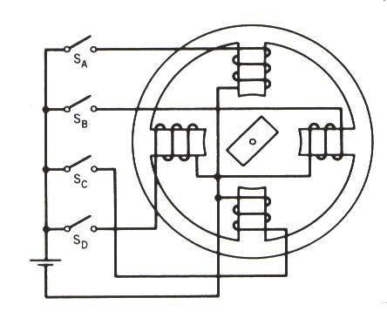
Full step mode
1
F
3
F
2
F
4
F

Slide 16
Full step mode
1
3
F
F
2
F
4
F

Slide 17
Full step mode
Same step size can be achieved using different coil commutation that results in different MMF. Same number of coils are active each step.
1
F
3
F
2
F
4
F

Slide 18
Half step
F
F
F
1
F
2
3
4

Slide 19
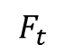
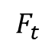
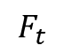
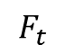
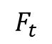
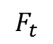
Full step: 3 Phases
A
A
B
C
1 Coil or “1-phase-on”
B
A
A
$$F_{t}$$
C
$$F_{t}$$
C
C
2 Coils or “2-phases-on”
$$F_{t}$$
B
B
A
$$F_{t}$$
3 Coils or “3-phases-on”
-C
$$F_{t}$$
C
A
B
-B
-A
B
$$F_{t}$$
C

Slide 20
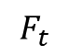
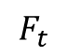
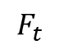
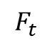

Half step: 3 Phases
A
1-2 Coils
A
A
$$F_{t}$$
B
C
B
B
3 Coils
-C
C
-B
A
$$F_{t}$$
C
-A
B
-A
B
$$F_{t}$$
-C
-A
$$F_{t}$$
B
$$F_{t}$$

Slide 21







Microstepping
With full and half stepping, current in the windings was either $I_{s}$ or $−I_{s}$.
Modern electronics allow to achieve any $I$ in the windings.
Let’s assume we have 2 perpendicular windings
With currents $I_{a}$ and $I_{b}$ flowing in them.
MMF’s produced by the coils are $F_{a}$ and $F_{b}$.
Total MMF $F_{tot}=\sqrt{F_{a}^{2}+F_{b}^{2}}$.
The angle $α=\arctan{\frac{F_{a}}{F_{b}}}$
$$F_{a}$$
A
B
$$F_{b}$$
$$F_{tot}$$
$$F_{a}$$
$$α$$
$$F_{b}$$

Slide 22







Microstepping
$$F_{a}$$
A
MMF’s produced by the coils are $F_{a}$ and $F_{b}$.
Total MMF $F_{tot}=\sqrt{F_{a}^{2}+F_{b}^{2}}$.
The angle $α=\arctan{\frac{F_{a}}{F_{b}}}$=$\arctan{\frac{I_{a}}{I_{b}}}$
To maintain constant $F_{tot}$ we can use current’s that satisfy:
$$I_{a}=I_{s}\cos{α}→F_{a}={NI}_{s}\cos{α}$$
$$I_{b}=I_{s}\sin{α}→F_{b}={NI}_{s}\sin{α}$$
$$F_{tot}=\sqrt{{\left({NI}_{s}\right)}^{2}(\cos^{2}{α}+\sin^{2}{α})}=NI_{s}$$
B
$$F_{b}$$
$$F_{tot}$$
$$F_{a}$$
$$α$$
$$F_{b}$$

Slide 23


Microstepping
$$I_{a}=I_{s}\cos{α}$$
$$I_{b}=I_{s}\sin{α}$$
To maintain a certain step size, currents must be changed according to the sin/cos relationship.
 | 1/3 step |  | 1/4 step |  | 1/5 step
Step nr | $I_{a}$ | $$I_{b}$$ | $I_{a}$ | $$I_{b}$$ | $I_{a}$ | $$I_{b}$$
0 | 1.00 | 0.00 | 1.00 | 0.00 | 1.00 | 0.00
1 | 0.87 | 0.50 | 0.92 | 0.38 | 0.95 | 0.31
2 | 0.50 | 0.87 | 0.71 | 0.71 | 0.81 | 0.59
3 | 0.00 | 1.00 | 0.38 | 0.92 | 0.59 | 0.81
4 |  |  | 0.00 | 1.00 | 0.31 | 0.95
5 |  |  |  |  | 0.00 | 1.00

Slide 24

Some definitions
Step- an action when a motor rotates by a step angle
Step angle- Angle that a motor rotates after an impulse
Input pulse frequency- frequency at which motor control impulses are produced. (Same as step frequency if motor is not missing steps)
Step frequency- number of steps per second when input pulse frequency is constant
Magnetic rest position- a point in which the magnetic torque is zero
Steps per revolution- number of steps for the motor to complete a 360$°$ turn.

Slide 25
Some definitions
Maximum starting frequency- maximal input pulse frequency able to start the motor without loosing steps
Pull-in torque- maximum torque that the motor can achieve synchronicity.
Pull-out torque- Maximum torque a stepper canmaintain without loosing synchronicity.
Accuracy- difference between theoretical and actual rotor position expressed as a ratio with the step angle. Usually, 5 %.

Slide 26


Reluctance stepper motors: basics
Reluctance motors are synchronous motors that do not have coils or magnets in their rotor. Rotor is comprised such that magnetic resistance would vary with rotation angle. In steppers, this is realized this by including teeth into rotor. Teeth represent path of lowest reluctance and the gaps- highest. This makes the rotor of salient type.
Highest reluctance
Lowest Reluctance
Lowest Reluctance
Highest reluctancex

Slide 27




Reluctance stepper motors: basics
In the picture below, the motor has 3 phases ($m=3$). Stator has 6 teeth $(Z_{s}=6$) that are connected 2 at a time, and the rotor has 4 ($Z_{r}=4$). The step angle and the number of steps per revolution only depend on the rotor pole pitch and the number of stator phases, not on the number of stator teeth.
$$N_{s}=m_{s}Z_{r}$$
$$α_{step}=\frac{360°}{Z_{R}m_{s}}$$
$$α_{step}=\frac{360}{3⋅4}=3$$
In 1-phase-on mode polarity does not matter as the rotor will assume the position of lowest reluctance

Slide 28




Step size and teeth
Varying between 3 and 4 phases in the stator and between $2−10$ teeth in the rotor, step angles between 60 and 9 degrees can be achieved.
Higher accuracy motors have high number of teeth on the rotor. This also requires to have teeth on the poles of the stator.
3 phases and 44 teeth
4 phases and 50 teeth
$$α_{step}=\frac{360°}{44∗3}=2.7°$$
$$α_{step}=\frac{360°}{50∗4}=1.8$$

Slide 29


Slide 30


Multi-stack stepping motors
Steppers can be built in layers. If they have more than one section, they are said to be multi-stack or cascade type. Rotor poles are rotated in each layer by $α_{rotor}$/$m_{s}$
Multi-stack VR stepping motor: a homopolar, b heteropolar

Slide 31
Homopolar Multi-stack stepping motors
Flux
In a single layer there are 2 sections for the north and south poles. The flux enters the rotor, travels axially to the south pole, leaves the rotor and travels back axially to complete the ciruit.
Only one coil is needed to produce the flux.
N
S

Slide 32

Heteropolar Multi-stack stepping motors
N
S
N
In the heteropolar type , the (stator) poles are alternating north and south poles in the same plane. This necessitates a coil around each stator pole,
i.e. a more complicated winding structure with space restrictions as well.

Slide 33

Multi-stack steppers
For both types, all poles of stator and rotor of the excited phase will align. For a three-phase motor, each layer is displaced by (1/3)rd of a pole pitch and the excitation of the next phase will cause the rotor to rotate further by 1/3 of the pole pitch. A small step angle thus requires a large number of poles (and a small pole pitch), for example 15$°$ for a three phase motor with eight teeth.

Slide 34

Permanent magnet steppers
Motor has a magnetized rotor. The magnetization in alternating NSNSNS around the rotor. Multi-stack steppers with PM are available. In this case rotor’s poles are not rotated in each layer but rather the poles in the stator.

Slide 35




Multi-stack four-phase claw pole motor
2 layers, 2 coils, but the coils need to be able to change polarity. 4 phase behavior is obtained. Claws act as poles and guide the magnetic field. This type is sometimes called tin can steppers.

Slide 36



Hybrid stepper motors
Hybrid stepping motors combine the torque effect of reluctance and permanent magnets. The rotor contains 2 toothed sections displaced by half tooth pitch. Axial permanent magnets are placed inside the rotor.
Stator construction remains the same, but the windings and connections are different: 2 coils on each pole are assigned to distinct phases. Invese variations are possible.

Slide 37

Hybrid stepper motor

Slide 38

Two-phase stepper motors
There are two basic winding arrangements for the
electromagnetic coils in a two phase stepper motor: bipolar and unipolar.
A unipolar stepper motor has one winding with center tap per phase. Each section of windings is switched on for each direction of magnetic field. Since in this arrangement a magnetic pole can be reversed without switching the polarity of the common wire, the commutation circuit can be simply a single switching transistor for each half winding. Typically, given a phase, the center tap of each winding is made common: giving three leads per phase and six leads for a typical two phase motor. Often, these two phase commons are internally joined, so the motor has only five leads.

Slide 39

Bipolar motors have a single winding per phase. The current in a winding needs to be reversed in order to reverse a magnetic pole, so the driving circuit must be more complicated, typically with an H-bridge arrangement. There are two leads per phase, none is common.

Slide 40


